Slide 1
NetDevOps: Automation on Bare Metal Switches
Intros
What is Open Networking? (Kevin)
Open hardware, ONIE, APD
Automation (Kevin)
Ansible playbooks, puppet manifests, etc for network configuration
CI/CD in a Network context (Russ)
Full stack testing
Demo (Russ)

Slide 2
Open Networking?
Open Hardware
ONIE
APD

Slide 3
Open Networking: What is It?
Is it?
Linux Foundation
ONF
SDN
Openflow
API
Or is it?
Freedom
Choice
Flexibility
Community

Slide 4
Open Networking: Why do I care?
Operational Flexibility
Innovate Faster
Control your back office destiny
Simple
Did I mention Cost?

Slide 5
Open Hardware

Slide 6

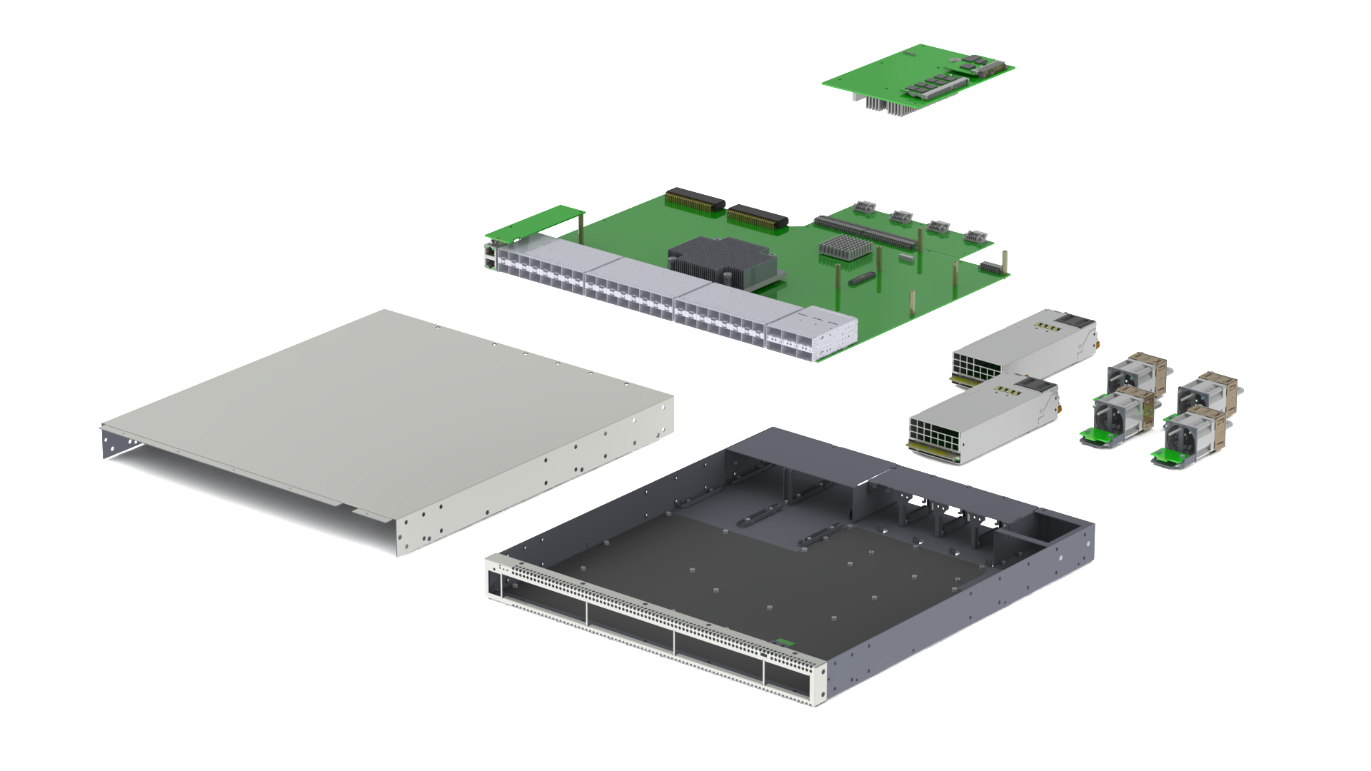

Open Networking: “Whitebox switch”

Slide 7
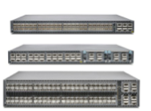
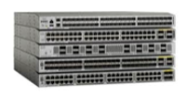
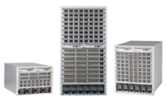
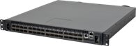
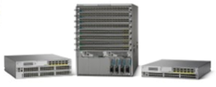
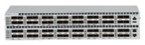

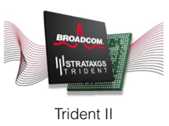
Industry-Standard Network Hardware
Juniper
Cisco
Arista
Brite-Box | White Box
Nexus 3100
7500E
HCL:
Agema, Dell Edge-Core, HPE, Mellanox, Penguin Computing,
Quanta, Supermicro
QFX 3500
7250X
Nexus 9000
*
powered by
* Spectrum not T2
Notes:
The same merchant silicon powers all vendors today in the data center.

Slide 8
APD

Slide 9
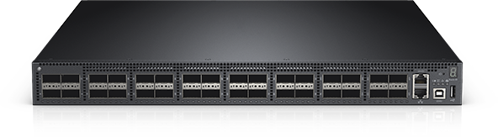
ACPI Platform Description (APD)
Standardizing Platform Description
ACPI extension for networking
used for PCs/servers
Cuts Platform integration time
months to days
Accelerate platform availability
Operating System
Before
Platform Specific Driver
Platform Specific Driver
Platform Specific Driver
Operating System
With APD
Generic Platform Driver
Description
Description
Description
Content Presented Under Embargo Until March 10, 2015 10 AM PT
Notes:
Ease network platform integration, let the hardware vendor control their destiny
Goal: Broader set of devices that people can leverage
With APD, you get a hardware abstraction. OS = keep everything generic. For anything platform specific, keep it in the platform
Disaggregate the model to make it fast to innovate
- Can support all types of architectures and switches
- Code embedded in the bios and we parse the information on the NOS
Cuts the human intervention, all automated
Upstreamed and in 4.4 kernel

Slide 10
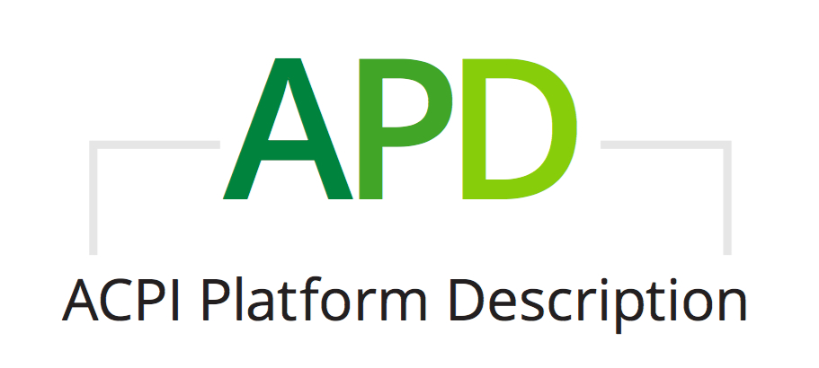
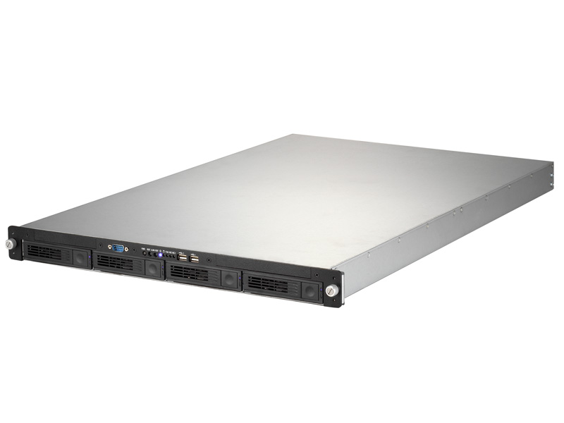
Open ecosystem for open networking to thrive
Servers
Switches
SERVER OS
NETWORK OS
Linux Networking Model
Load any OS on any platform
uboot and PXE
Self-described platform to any OS
ACPI
Notes:
Ease network platform integration, let the hardware vendor control their destiny
Goal: Broader set of devices that people can leverage
With APD, you get a hardware abstraction. OS = keep everything generic. For anything platform specific, keep it in the platform
Disaggregate the model to make it fast to innovate
- Can support all types of architectures and switches
- Code embedded in the bios and we parse the information on the NOS
- Cuts the human intervention, all automated

Slide 11
ACPI
Without ACPI
Steps
0, 1
Port
ONIE
Port
OS
Test
Ship
With ACPI
Port
ONIE
Describe
Platform
Certify
Ship
Standards Based OS Vendor Specific
Notes:
green = standards based
stacked = done in parallel by multiple hardware vendors
moves platform description over to the standards based, parallel hardware vendor side
This is a standard practice for servers. Tools are open.
Testing
spread out more
hardware vendors self certify, hopefully catch most of the bugs
OS vendors certify
OS Agnostic

Slide 12
ONIE

Slide 13
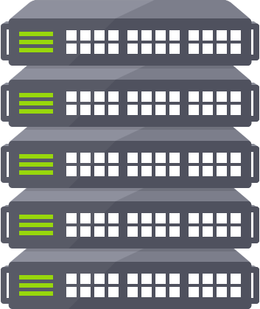
Open Networking: What’s an ONIE?
“PXE that doesn’t suck”
Cumulus Networks contribution to OCP
Enhanced Boot loader of Linux Kernel + BusyBox
Enables install NOS of your choice
Notes:
http://onie.org/about/
https://busybox.net/about.html
BusyBox: The Swiss Army Knife of Embedded Linux
BusyBox combines tiny versions of many common UNIX utilities into a single small executable. It provides replacements for most of the utilities you usually find in GNU fileutils, shellutils, etc. The utilities in BusyBox generally have fewer options than their full-featured GNU cousins; however, the options that are included provide the expected functionality and behave very much like their GNU counterparts. BusyBox provides a fairly complete environment for any small or embedded system.
BusyBox has been written with size-optimization and limited resources in mind. It is also extremely modular so you can easily include or exclude commands (or features) at compile time. This makes it easy to customize your embedded systems. To create a working system, just add some device nodes in /dev, a few configuration files in /etc, and a Linux kernel.

Slide 14
Just Add Network OS

Slide 15

Bare No More: The Emperor has Cloths!
Hmm… a Server with 32 100G LINE-RATE NIC’s?
switchd
Routing
Bridging
Network
Interfaces
Netfilters
Tunneling
LINUX KERNEL
Industry-Standard Hardware
Switch Silicon
CPU
RAM
Flash
Power
Fan
Front Panel Ports
Notes:
Animation

Slide 16
Open Networking Forecast
Snowflakes are hard to manage!
Where we’ve been
Transition feels like.
What took so long?
No More Snowflakes!
Notes:
Snowflake slide with frosty the snowman melting
Everyone loved frosty, and he represents the traditional networking world where every network is a special build
If we want to automate and have more predictability we need fewer snowflakes

Slide 17
Automation
Basics of booting a switch
Ansible Playbooks
Puppet manifests

Slide 18
Traditional Networking Dragging you Down?
Open Networking Free Fly Zone!
Notes:
Which one are you?

Slide 19
Configuration errors…. That never happens!
Human Errors
Inconsistent
Unpredictable
Difficult to find
Machine Errors
Consistent
[typically] easy fix
Caused by {see sample A}

Slide 20
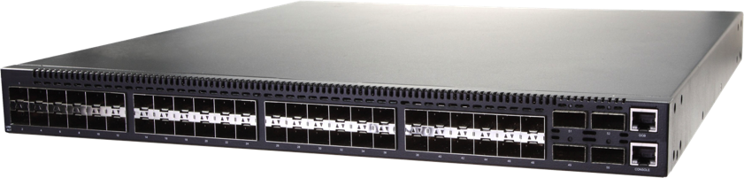
ONIE and ZTP – The basics
DHCP Request with ONIE Option
DHCP Address with URL for OS Image
OS Boots
DHCP Request with ZTP Option
DHCP Address with script URL
Baseline Configuration Applied
Pull Puppet/Chef/Ansible Scripts
Device Specific Configuration Applied

Slide 21
ZTP with DHCP - example dhcp.conf
ddns-update-style none;
default-lease-time 4320;
max-lease-time 8640;
authoritative;
option cumulus-provision-url code 239 = text;
subnet 192.168.0.0 netmask 255.255.255.0 {
range 192.168.0.100 192.168.0.200;
option routers 192.168.0.1;
option domain-name-servers 192.168.0.1;
option domain-name "lab.mycompany.com";
option cumulus-provision-url "http://192.168.0.1/provision.sh";
}

Slide 22
ZTP Scripts can be Powerful and/or Simple
#!/bin/bash
# Upgrade and install Puppet
apt-get update –y
apt-get upgrade –y
apt-get install puppet –y
echo "Configuring puppet" | wall –n
sed -i /etc/default/puppet -e 's/START=no/START=yes/’
service puppet restart
# CUMULUS-AUTOPROVISIONING
exit 0
#!/bin/bash
mkdir -p /root/.ssh
/usr/bin/wget -O /root/.ssh/authorized_keys http://192.168.0.1/ssh.keys
#CUMULUS-AUTOPROVISIONING

Slide 23

NetDevOps: Automation Use Cases
OBM
OBM
OBM
Rapid Provisioning
Hot Swap the Whole Switch
Configuration Management
Weeks and months now take seconds
Pods of equipment can be stamped out in multiple locations
With automation the whole switch can be replaced and provisioned
High capacity, fine-grained failure domain
Infrastructure as code
Enforcement from central location
Easy change control
Notes:
Once you understand the power of choice and solutions brought about by Cumulus Linux, the next step is to integrate Cumulus Linux into brownfield and greenfield architectures.
IP Fabrics are the most flexible network architectures when it comes to high capacity, scale and evolution.
Enables Scale-out architecture
Easy to configure and troubleshoot
Easy to add new racks
Standard OSPF/BGP – helps with interoperability
Can be used as an underlay in conjunction with Network Virtualization Overlays
Network Virtualization Overlays add additional flexibility
Flexible Virtual Network
Scalable, Multi-tenant
Integrated with Cloud Orchestration tools
Yet, they need a simple migration path coexistent with their existing network architecture
CL2.5 brings the flexibility of L2MLAG network architectures
CL2.5 brings the flexibility of L2MLAG network architectures. Customers can now drop in a networking hardware running Cumulus Linux in existing environments and migrate at their pace and based on the needs to Modern DC networks.
FHRP, Improved Linux-bridging and ifupdown2 integration for required L2 fabrics, L2 scale

Slide 24
NetDevOps: Automation Use Cases
OBM
OBM
OBM
Easy Application Deployment
Maintenance Tasks
User Administration
No need to know how to install an App on Linux
Apps can be installed, configured and up and running with one command
Automate maintenance tasks such as log and space cleanup, patching applications, etc
Shortened change-windows and less down-time
Kick off user customization for new hires
Revoke user permissions as they change job roles
Notes:
Once you understand the power of choice and solutions brought about by Cumulus Linux, the next step is to integrate Cumulus Linux into brownfield and greenfield architectures.
IP Fabrics are the most flexible network architectures when it comes to high capacity, scale and evolution.
Enables Scale-out architecture
Easy to configure and troubleshoot
Easy to add new racks
Standard OSPF/BGP – helps with interoperability
Can be used as an underlay in conjunction with Network Virtualization Overlays
Network Virtualization Overlays add additional flexibility
Flexible Virtual Network
Scalable, Multi-tenant
Integrated with Cloud Orchestration tools
Yet, they need a simple migration path coexistent with their existing network architecture
CL2.5 brings the flexibility of L2MLAG network architectures
CL2.5 brings the flexibility of L2MLAG network architectures. Customers can now drop in a networking hardware running Cumulus Linux in existing environments and migrate at their pace and based on the needs to Modern DC networks.
FHRP, Improved Linux-bridging and ifupdown2 integration for required L2 fabrics, L2 scale

Slide 25
NetDevOps: Automation Use Cases
OBM
OBM
OBM
Reactive Network Changes
Hitless Upgrades
Automatic Threat Response
Bad fan? High Temperature? Don’t just know when it happens but automatically respond
Bring switches offline automatically without affecting the network
Check surrounding devices and check route tables to know network state
Deter threats as they happen rather than ‘when’ you notice
Grab logging information and make it easy to see the attack vector
Notes:
Once you understand the power of choice and solutions brought about by Cumulus Linux, the next step is to integrate Cumulus Linux into brownfield and greenfield architectures.
IP Fabrics are the most flexible network architectures when it comes to high capacity, scale and evolution.
Enables Scale-out architecture
Easy to configure and troubleshoot
Easy to add new racks
Standard OSPF/BGP – helps with interoperability
Can be used as an underlay in conjunction with Network Virtualization Overlays
Network Virtualization Overlays add additional flexibility
Flexible Virtual Network
Scalable, Multi-tenant
Integrated with Cloud Orchestration tools
Yet, they need a simple migration path coexistent with their existing network architecture
CL2.5 brings the flexibility of L2MLAG network architectures
CL2.5 brings the flexibility of L2MLAG network architectures. Customers can now drop in a networking hardware running Cumulus Linux in existing environments and migrate at their pace and based on the needs to Modern DC networks.
FHRP, Improved Linux-bridging and ifupdown2 integration for required L2 fabrics, L2 scale

Slide 26
Provisioning Playbooks

Slide 27
Project Tree Troubleshooting

Slide 28
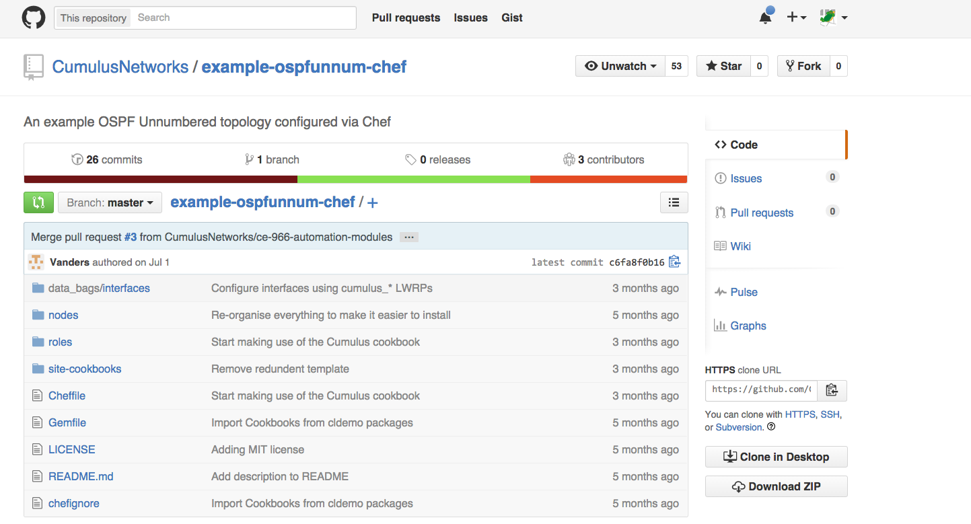
Infrastructure as Code
Where are my configs?
Configuration for network nodes is stored:
Cookbooks
Manifests
Playbooks
Revision control tools:
Git (Stash, Github)
Subversion
Mercurial
Clearcase
CVS

Slide 29
Pick’em - Automation Tools
Agentless | Agent-based
Requires no additional application software | Requires installation of an application (e.g., a daemon) to communicate with the control server
Relies on existing processes (such as SSH) to communicate with the control server | May also use existing processes to perform its functions
Notes:
Speaking Points: Automation tools are either agent-based or agentless.
Agent-based tools require the installation of code on the managed device. This allows two-way communication with the control server (i.e., either the server or client can initiate actions). The agent will consume local system resources to run.
Agentless tools require no additional software to be installed on the managed device. However, without a local component, all actions must be initiated by the control server. The server will rely on other software (such as SSH) to communicate with the managed device.

Slide 30

Want to learn more?
Community
http://community.cumulusnetworks.com/
Slack Channel
cumulusnetworks.slack.com
Download Cumulus VM’s
https://cumulusnetworks.com/cumulus-vx/
Demo’s and Lab’s: https://support.cumulusnetworks.com/hc/en-us/articles/201787686 https://support.cumulusnetworks.com/hc/en-us/sections/200398866

Slide 31
artisan|ˈärtəzən| noun a person or company that makes a high-quality or distinctive product in small quantities, usually by hand or using traditional methods.
“Artisan working meticulously on a wooden sculpture” by Piseth1 is licensed under CC-BY-SA-3.0
Notes:
Artisanal Networking is the time-consuming, traditional method of managing networks. We’ve been doing this device-by-device configuration method for decades and it needs to stop!
No more Artisanal Networking

Slide 32
CI/CD in a Network Context
CI/CD was originally intended for software
CI/CD evolves and matures into DevOps
Network Configuration is now code
Desired outcomes for NetDevOps:
Raise quality and value of the Infrastructure AND the services on top of it
Spend less time on unplanned work & rework [1]
Stop creating snowflakes
Automate repetitive tasks
All changes go through Code Control
Operational Improvement with NetDevOps
Capacity Planning
Automate troubleshooting steps / information gathering
Automate maintenance events and engaging “Smart Hands”
[1] “2016 State of DevOps” Report from Puppet

Slide 33
No more Excel templating for network devices!
“Arithmetical machine with neperian cylinders” by René Grillet is licensed under CC-BY-SA-3.0
Notes:
Excel Templating

Slide 34
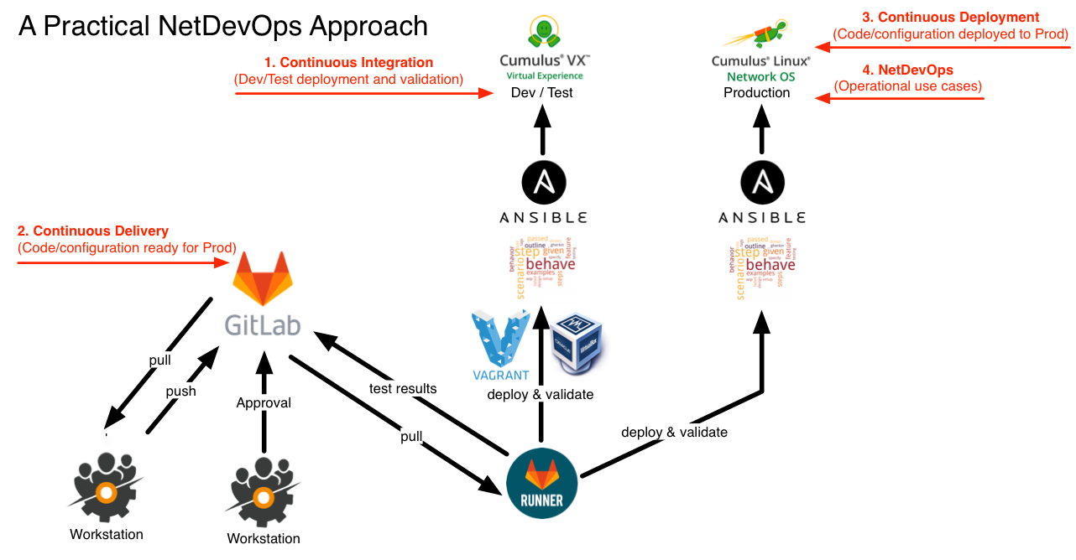

Slide 35
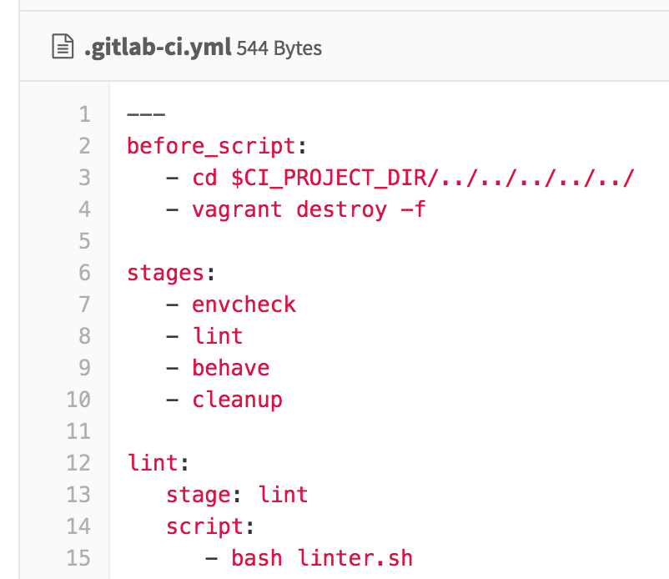
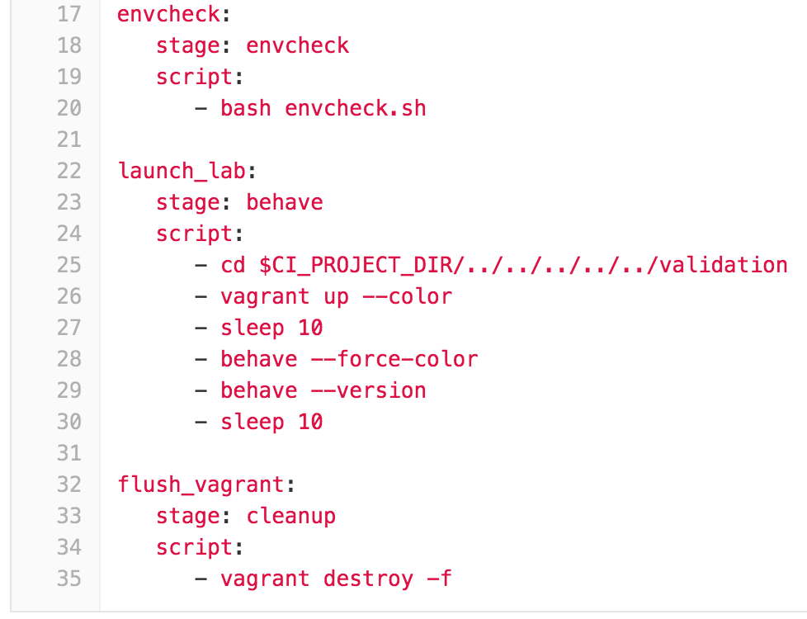
GitLab CI Anatomy

Slide 36
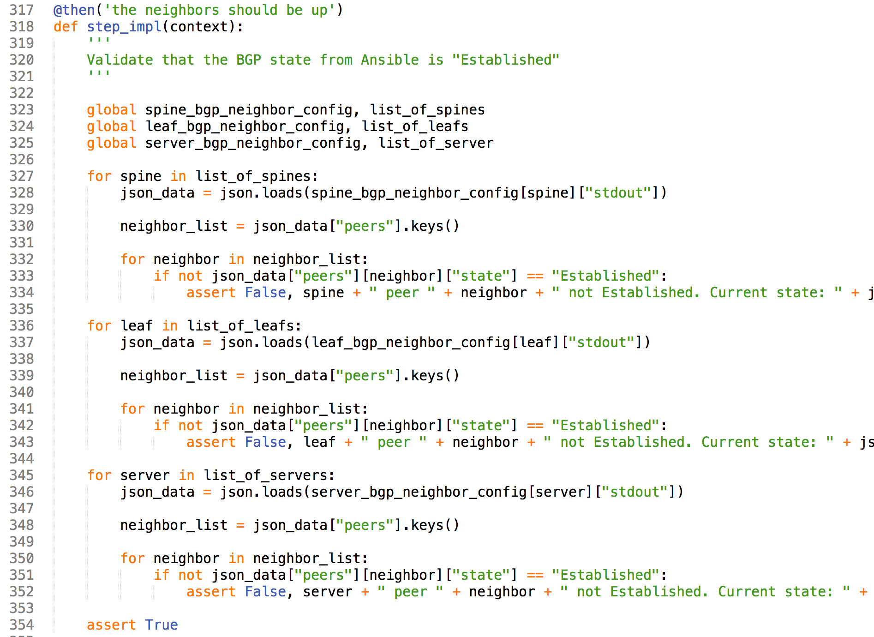
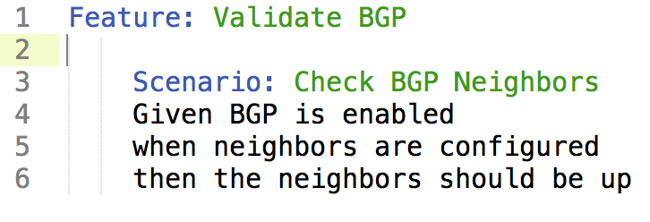
Behave
Backing Python code
./validation/steps/bgp.py
Behavior-Driven Development (BDD)
Natural Language Tests
“feature” code
./validation/bgp.feature

Slide 37
Full Stack Testing
NETWORK
CONFIGURATION
IAAS
CONFIGURATION
SERVICE
CONFIGURATION
STP (or not)
Keystone
winbind
LACP / MLAG
Horizon
Base OS Settings
BGP
Object Storage
splunk
Switches
HEAT
haproxy
Ansible
Subnets
Puppet
Cinder
Chef
syslogd
VLANs
Glance
ruby
Switch Ports
Neutron
Zabbix
VXLAN / Overlay
Nova
MySQL
Routers
Midokura
apache2
Behave
Tempest
Test Kitchen
GitLab CI Runner
Notes:
Snowflakes
Excel Templating
Proprietary Network OS
Limited Test / Validation / Review
Limited Configuration Control
Verification with Ping & Traceroute

Slide 38
Demo
GitLab project overview
Repo, Pipelines, and Runners
GitLab Runner overview
Good change: Update MOTD
Bad change: Routing typo / lint failure

Slide 39
